Slide 1

Data wrangling
Read your local dataset
Select variables/rows/colums, and make your sub dataset
How to treat missing observations
IGSIN 919 Qinyi Liu

Slide 2
Read data – set right local path
setwd(‘/local/right/path’) # put your dataset’s local path here
getwd() #check your current local path

Slide 3
read data – csv file and excel file
read.csv is a function that used to load your dataset
Most important arguments
Header (whether there are variable labels)
sep(separation sign)
dec(decimal sign)
quote(whether other signs should be discarded)
If your file is a excel file (xls or xlsx) , use the following code or you can transfer your excel file to csv file
library("readxl")
my_data <- read_excel("my_file.xls") # xls files
my_data <- read_excel("my_file.xlsx") # xlsx files

Slide 4
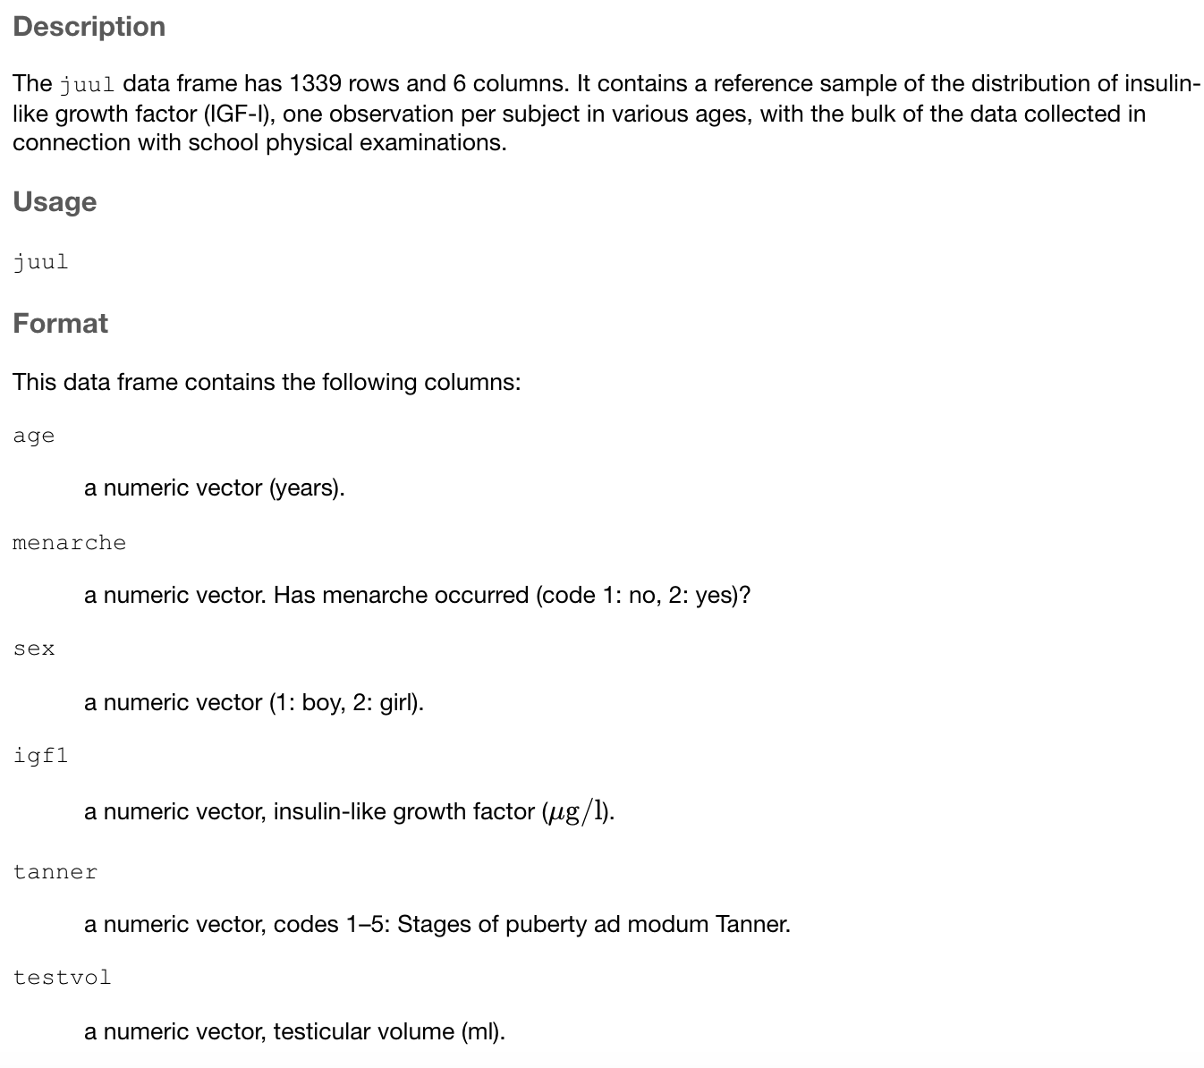
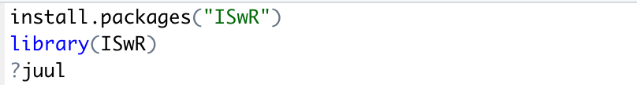
Juul dataset
Run the code
Get a sense of the dataset

Slide 5

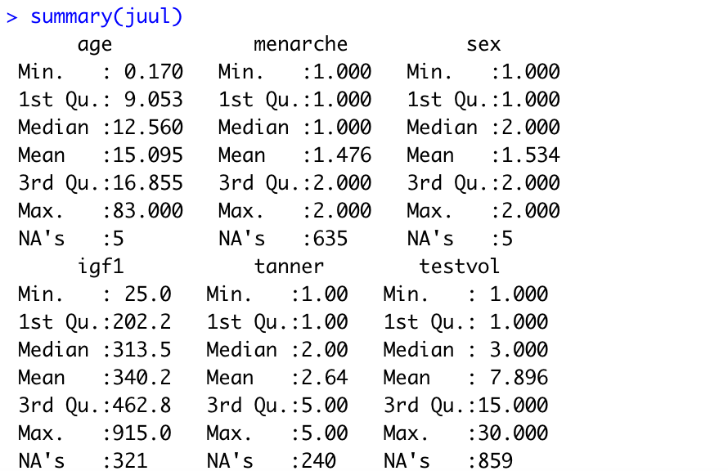
Get a sense of a new dataset
Run the following code to get a sense of the new dataset

Slide 6
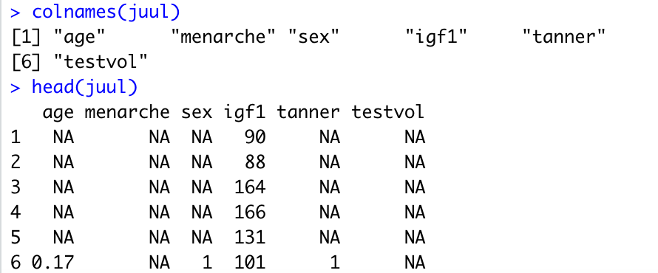
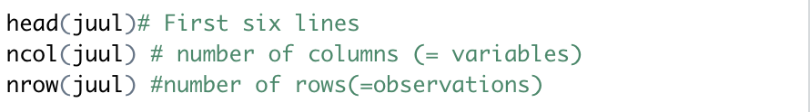
Get a sense of a new dataset
Inspection

Slide 7
select dataframe
Select from dataframe juul[,"sex"] # the column labelled ‘sex’
juul[,2] # the second column
Select from dataframe juul[juul$sex==2,] # select all data for females juul$age[juul$sex==2] # select only age of females juul$age[juul$igf1>400] # select only age for those with igf1 > 400

Slide 8
select
Function subset
df_new<-subset(juul, sex==1, c(age, igf1))

Slide 9
tidyverse
Install.package (“tidyverse”)
tidyr
dyplr
ggplot2
readr
purr
tibble

Slide 10
select
Used to make a selection on your dataframe using a variable from the dataframe
df %>% select(c(Q3, Q4, Q5))
%>% allows you to write short code
Statement before %>% shows the outer part of the function (df), after %>% the action to be performed on df

Slide 11
select
Overwrite the dataframe:
df <- df %>%
select(c(Q3, Q4, Q5))
This is the same as
df <- df[, c(Q3, Q4, Q5)]
You cannot go back to the previous version of the dataframe! All variables except Q3,Q4,Q5 are deleted

Slide 12
filter
Remove observations:
df <- df %>%
filter(sex == 1)
This is the same as the indexing command
df <- df[df$sex==1,]

Slide 13
How to treat with missing values
There are several functions to deal with them
complete.cases is.na na.rm
Select cases when missing values: juul[juul$sex==1 & !is.na(juul$sex),] juul[juul$sex==1 & complete.cases(juul$sex),]

Slide 14
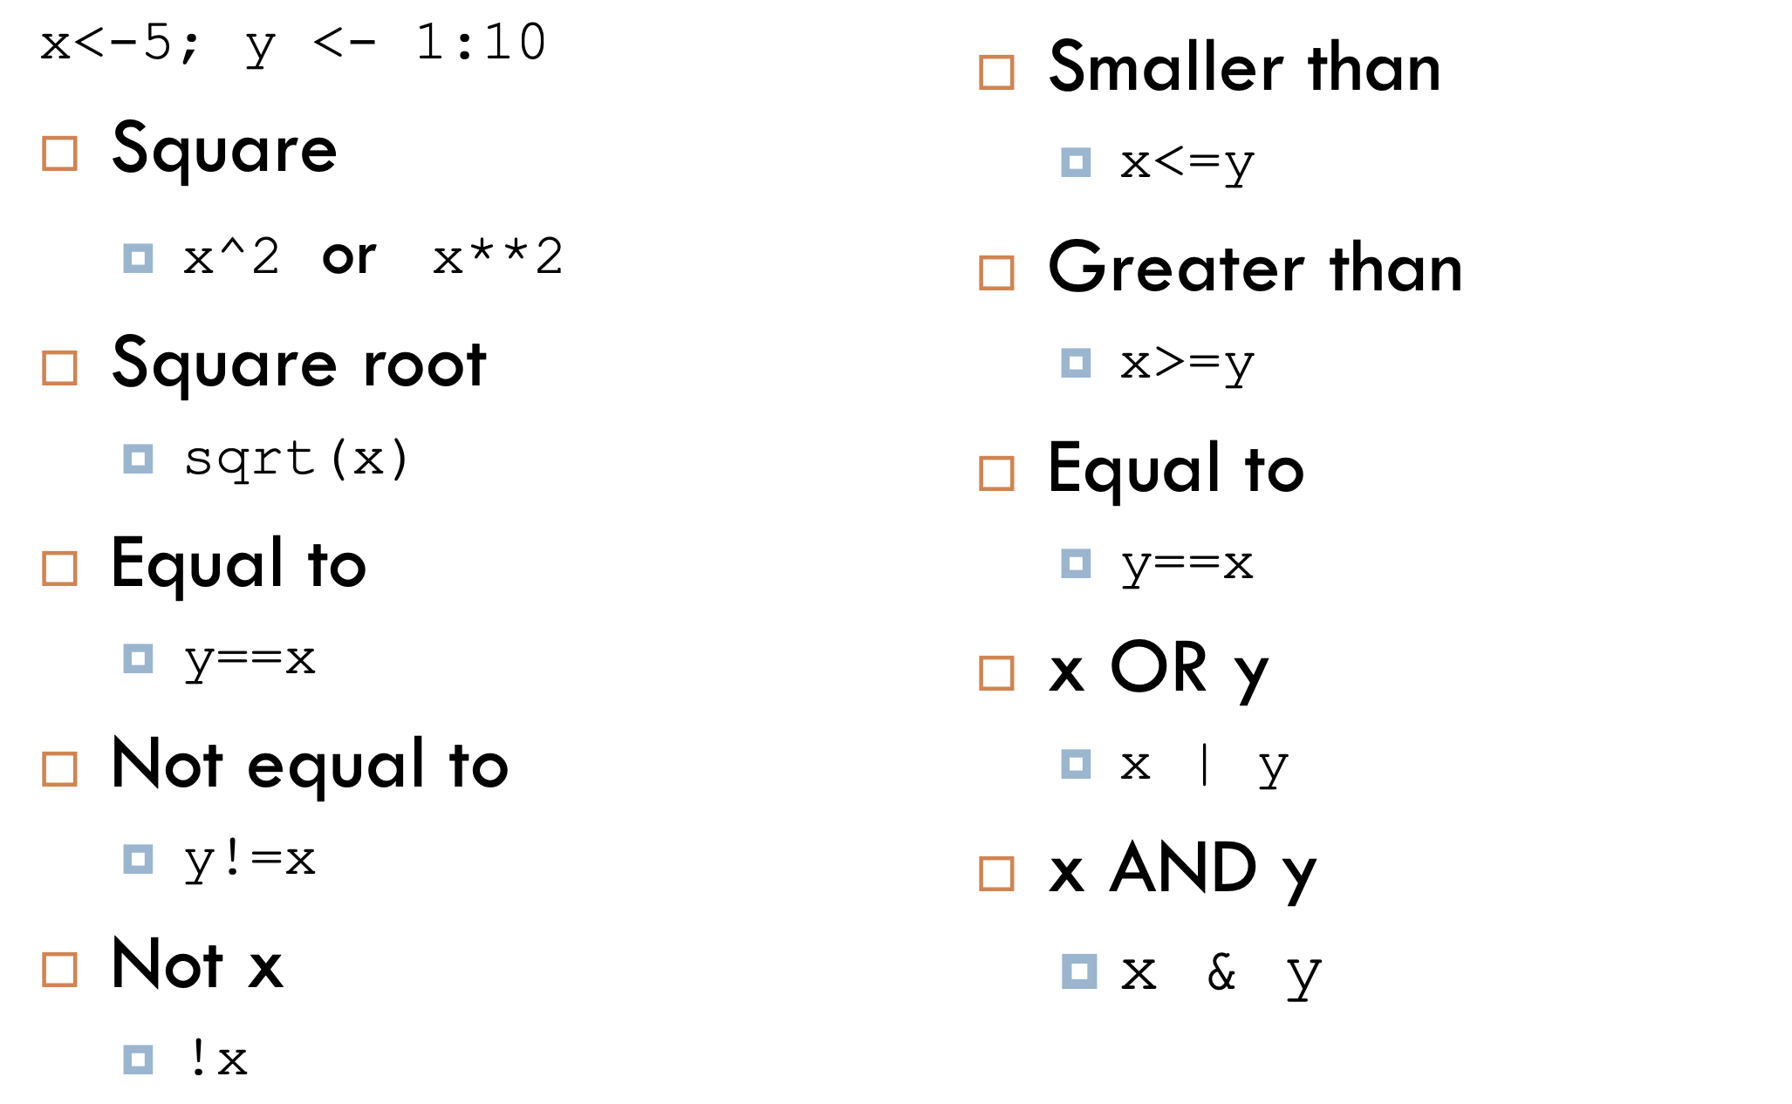
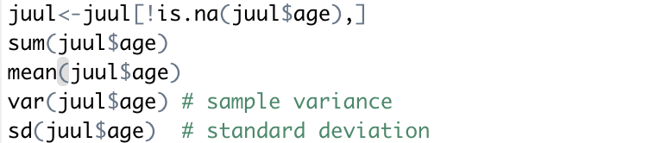
R as calculator
Arithmetic functions

Slide 15
Lab activity 3
Download imdb.csv data from mitt uib
Read this csv
Explore elements, rows, colums
create subset of mystery movies

